Slide 1
ECSE 422 Programming Project
Andrei Sandor, Nitin Kaudun, Kaicheng Wu

Slide 2
Glossary
Configuration - A set of edges that are present in the final design (eg {a,b,c} from {a,b,c,d,e,f})
State - A possible state of a configuration (eg a’bc from {a,b,c})
Rall - Reliability/probability that all cities will be connected in a given configuration

Slide 3
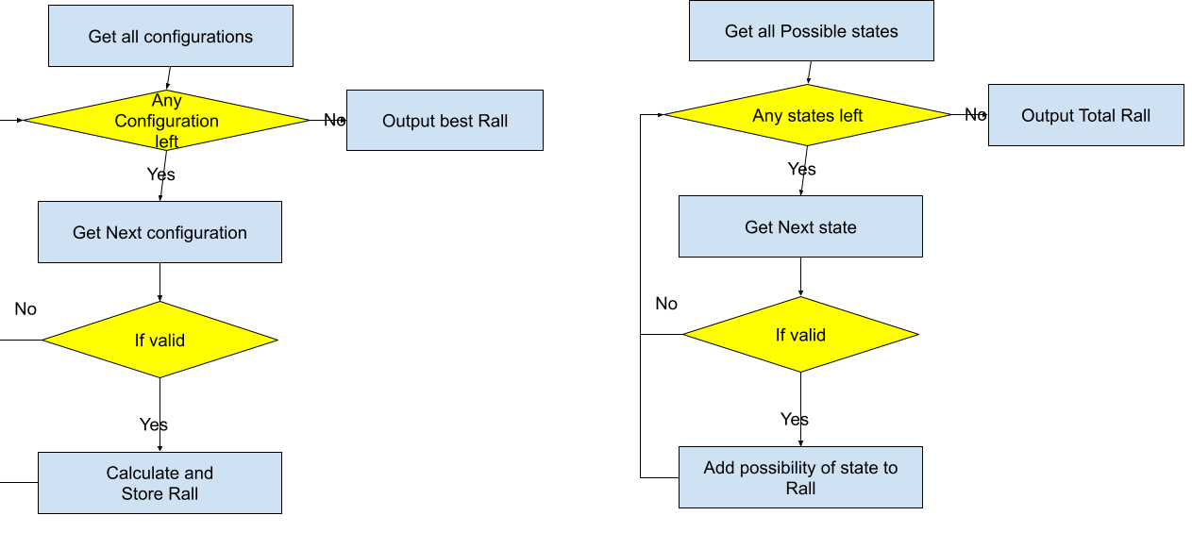
Exhaustive Enumeration

Slide 4
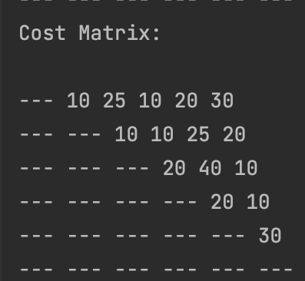
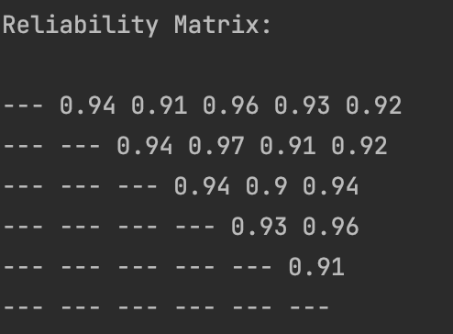
Exhaustive Enumeration
Initial steps 1. Parsing the input files to get the matrices for cost and reliability.

Slide 5
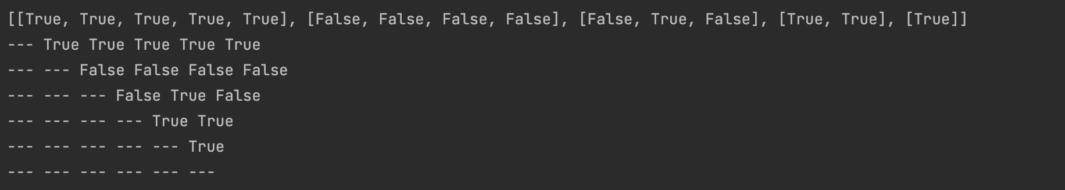
Exhaustive Enumeration
2. Generate all the possible options as a list of lists that will be transformed into a square matrix similar in shape as the cost and square matrices. Each option is a matrix of boolean to indicate which edge is included

Slide 6
Exhaustive Enumeration
3. For each option, we retrieve the cost which is a simple double for loop check to retrieve the cost from the cost matrix. After that, we check if the option visits all the cities by doing a breadth first search (BFS).
If the cost is exceeded or the configuration is not valid, we move on to the next configuration.

Slide 7
Exhaustive Enumeration
4. After those MST cases, we compute our reliability by using what we found from an MST/previous calculation of not a minimum spanning tree by considering the edge that we added to the connection.
We calculate the probability of all edges being up and add that result to the storage. For each value stored, check if the value is a subset. If the value is a subset, multiply the value of the subset being up and the rest of the edges being down. Add up all the values and you get Rall

Slide 8
Exhaustive Enumeration
5. For each configuration, we calculate Rall. We do this by calculating the probability of all states.
Eg. Given edges abc
P(a’b’c’)
P(abc’)
P(ab’c)
P(ab’c’)
Etc …
We then add the probability of all the states that still connect all vertices.

Slide 9
Exhaustive Enumeration
5. We then output the configuration with cost less or equal to the limit and best Rall.

Slide 10
Attempt Towards a More Efficient Algorithm
After some research and implementation attempts, we realized that maximizing the reliability of a network while under a cost constraint is a NP-Hard problem:
Which means it’s highly unlikely that an optimal solution can be found under exponential time.
Thus, we decided to approach this problem in a greedy way. This way we could get a “somewhat decent” solution while keeping the run-time manageable.

Slide 11
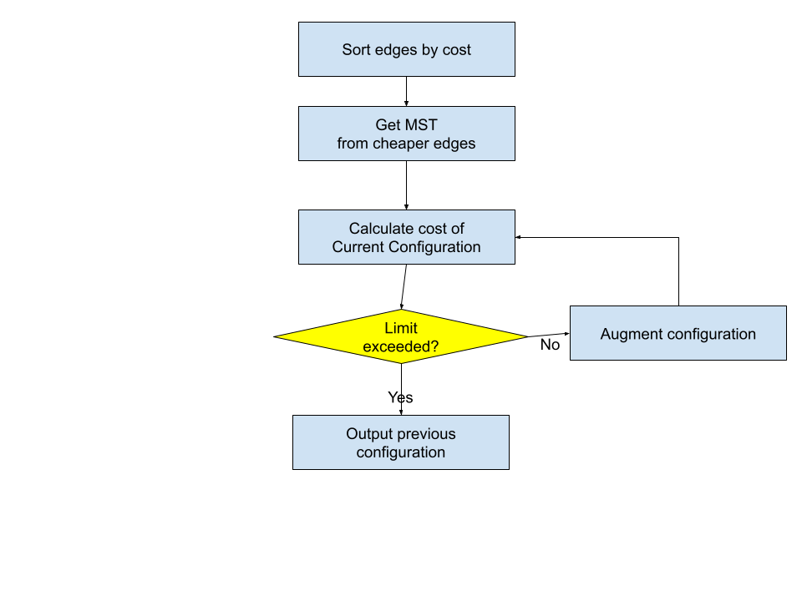
Greedy Algorithm for Network Design

Slide 12
Greedy Algorithm for Network Design
Step 1.
First, we create a barebone edge assignment that connects all cities (a MST) by using Prim’s algorithm.
This MST represents a basic network design connecting all cities and serves as the starting point of our greedy algorithm.

Slide 13
Greedy Algorithm for Network Design
Step 2
Then, we keep augmenting the MST by adding new edges until the cost limit has been reached.
We have three heuristics (we run them in parallel):
Lowest Cost
Highest Reliability
Highest Reliability per Cost

Slide 14
Heuristic - Lowest Cost
This one is simple:
Order all unselected edges by their cost and select the edge with lowest cost to add to the graph in each step.
Repeat the process until the cost limit has been reached.

Slide 15
Heuristic - Highest Reliability
Unlike cost, we could not simply order edges by their reliability as some edges with lower individual reliability can actually contribute more overall reliability to the graph since they form a cycle with other edges and provides redundancy:
For each unselected edge, create a “candidate graph” by tentatively adding that edge to the graph.
Individually compute the reliability of each candidate, the one with the highest reliability will be selected as the offspring.
Repeat the process on the selected candidate until the cost limit is reached.

Slide 16
Heuristic - Highest Reliability per Cost
Similar idea to highest reliability.
Instead of highest reliability, the ideal offspring is selected by the highest overall reliability to cost ratio.

Slide 17
Greedy Algorithm for Network Design
Step 3
Finally, we compare the results obtained from the 3 heuristics and select the best one as our final solution.

Slide 18
Limitation
Obviously, this greedy approach does not guarantee an optimal solution:
If Prim’s algorithm doesn’t generate a MST that is part of the optimal solution, we are cooked 🍳.
Each augmentation step can select an edge that is locally optimal but not globally optimal.
However, it is guaranteed to terminate in reasonable time and usually generates a pretty decent (often optimal) solution.

